Slide 1
GCS
Google Cloud Storage

Slide 2
FYI
https://github.com/avelino/awesome-go

Slide 3
GCS
Google Cloud Storage

Slide 4
Which way?
P12 / PEM
no
https://cloud.google.com/appengine/docs/go/googlecloudstorageclient/getstarted
gcloud - aedeploy
yes - if managed VM
https://cloud.google.com/
https://cloud.google.com/docs/
https://cloud.google.com/go/
https://cloud.google.com/go/getting-started/using-cloud-storage
JSON
yes - if app engine
https://godoc.org/google.golang.org/cloud/storage
https://godoc.org/golang.org/x/oauth2/google

Slide 5
GCS
Google Cloud Storage

Slide 6
https://cloud.google.com/appengine/docs/go/googlecloudstorageclient/
Buckets, objects, and ACLs
Modifying Cloud Storage objects
Cloud Storage and subdirectories
Alternative methods for accessing Cloud Storage

Slide 7
https://cloud.google.com/appengine/docs/go/googlecloudstorageclient/activate
Create a bucket

Slide 8
https://cloud.google.com/appengine/docs/go/googlecloudstorageclient/download
go get -u google.golang.org/cloud/storage

Slide 9
setting up dev authorization

Slide 10
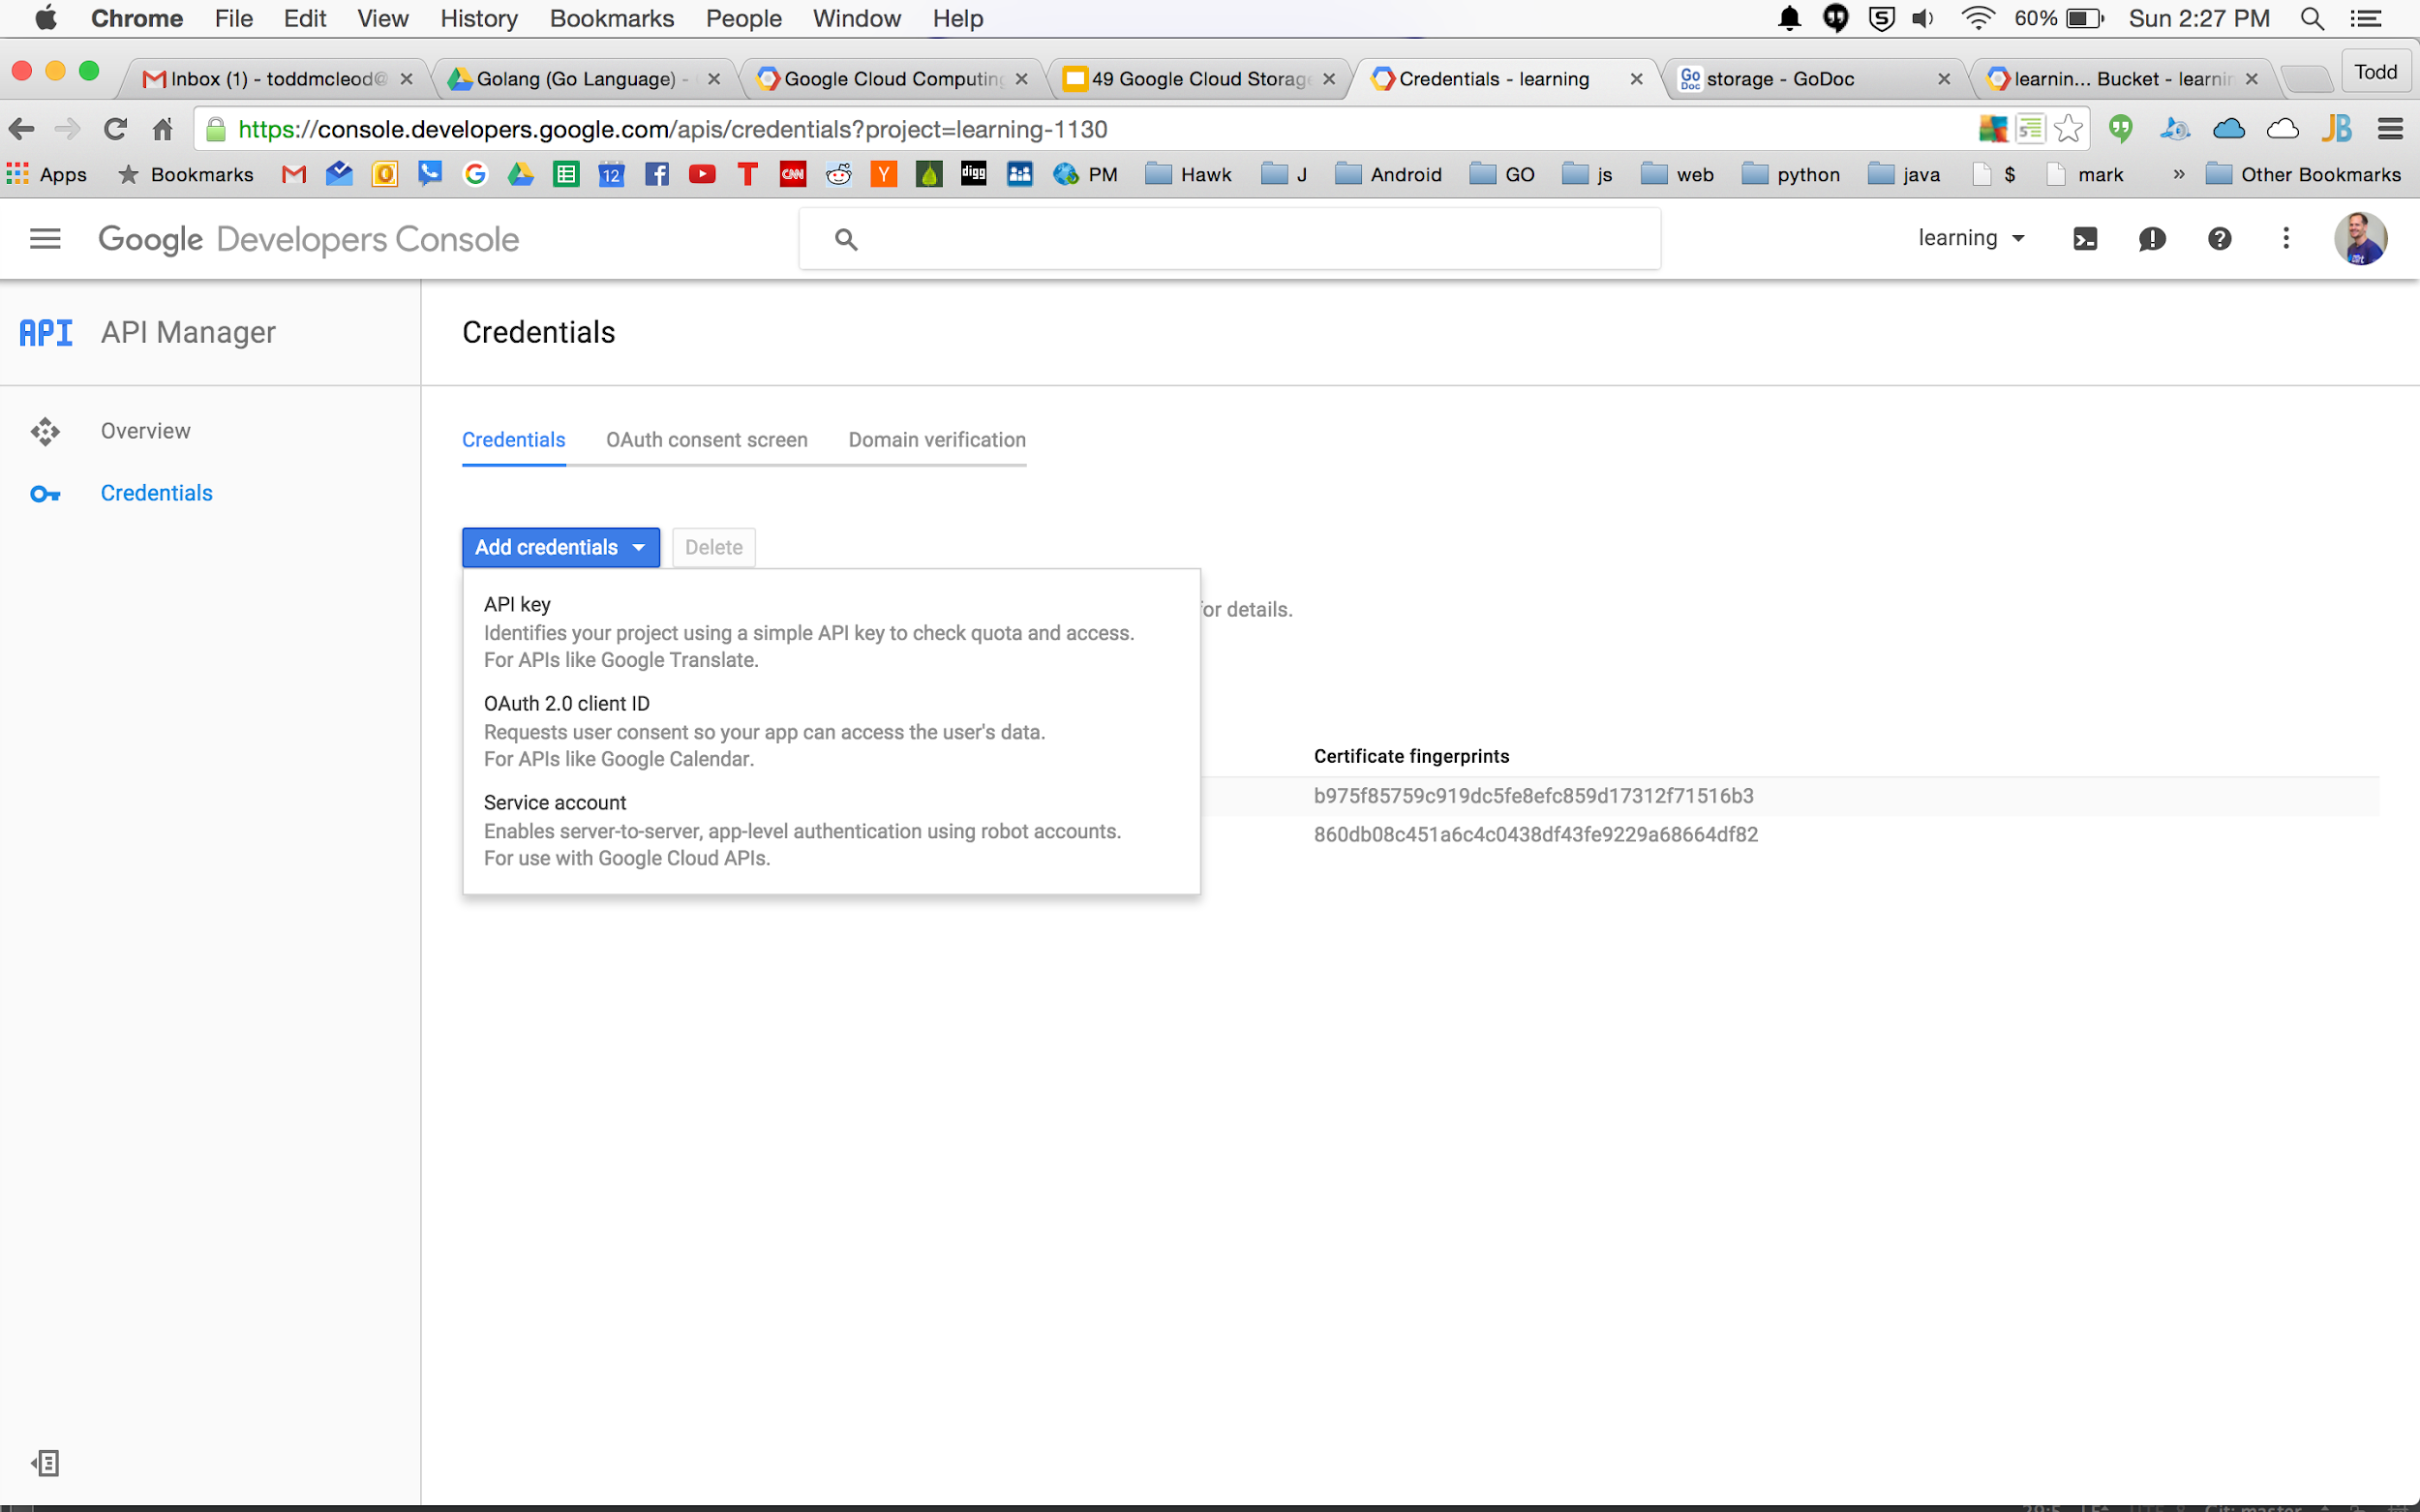

Slide 11
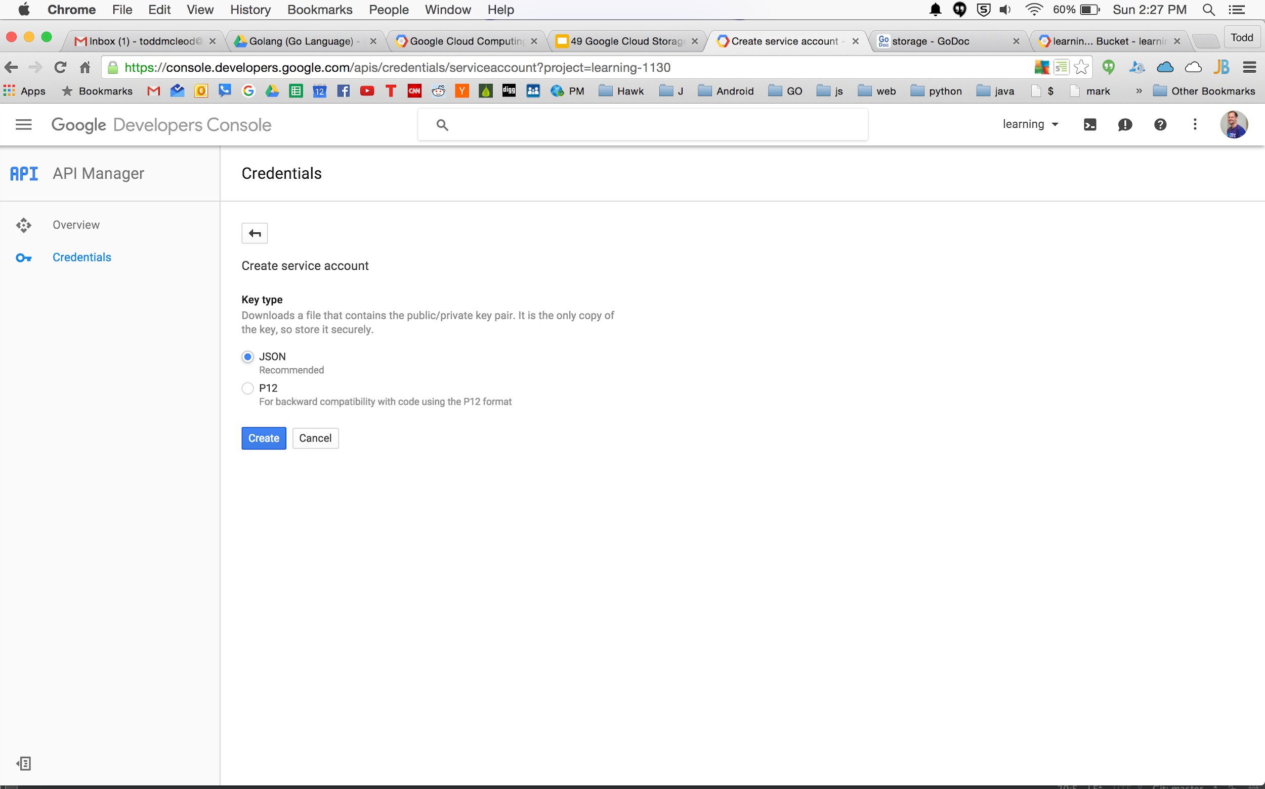

Slide 12
P12 → PEM AUTH
(old way)

Slide 13
code
write code for your app to work with GCS

Slide 14
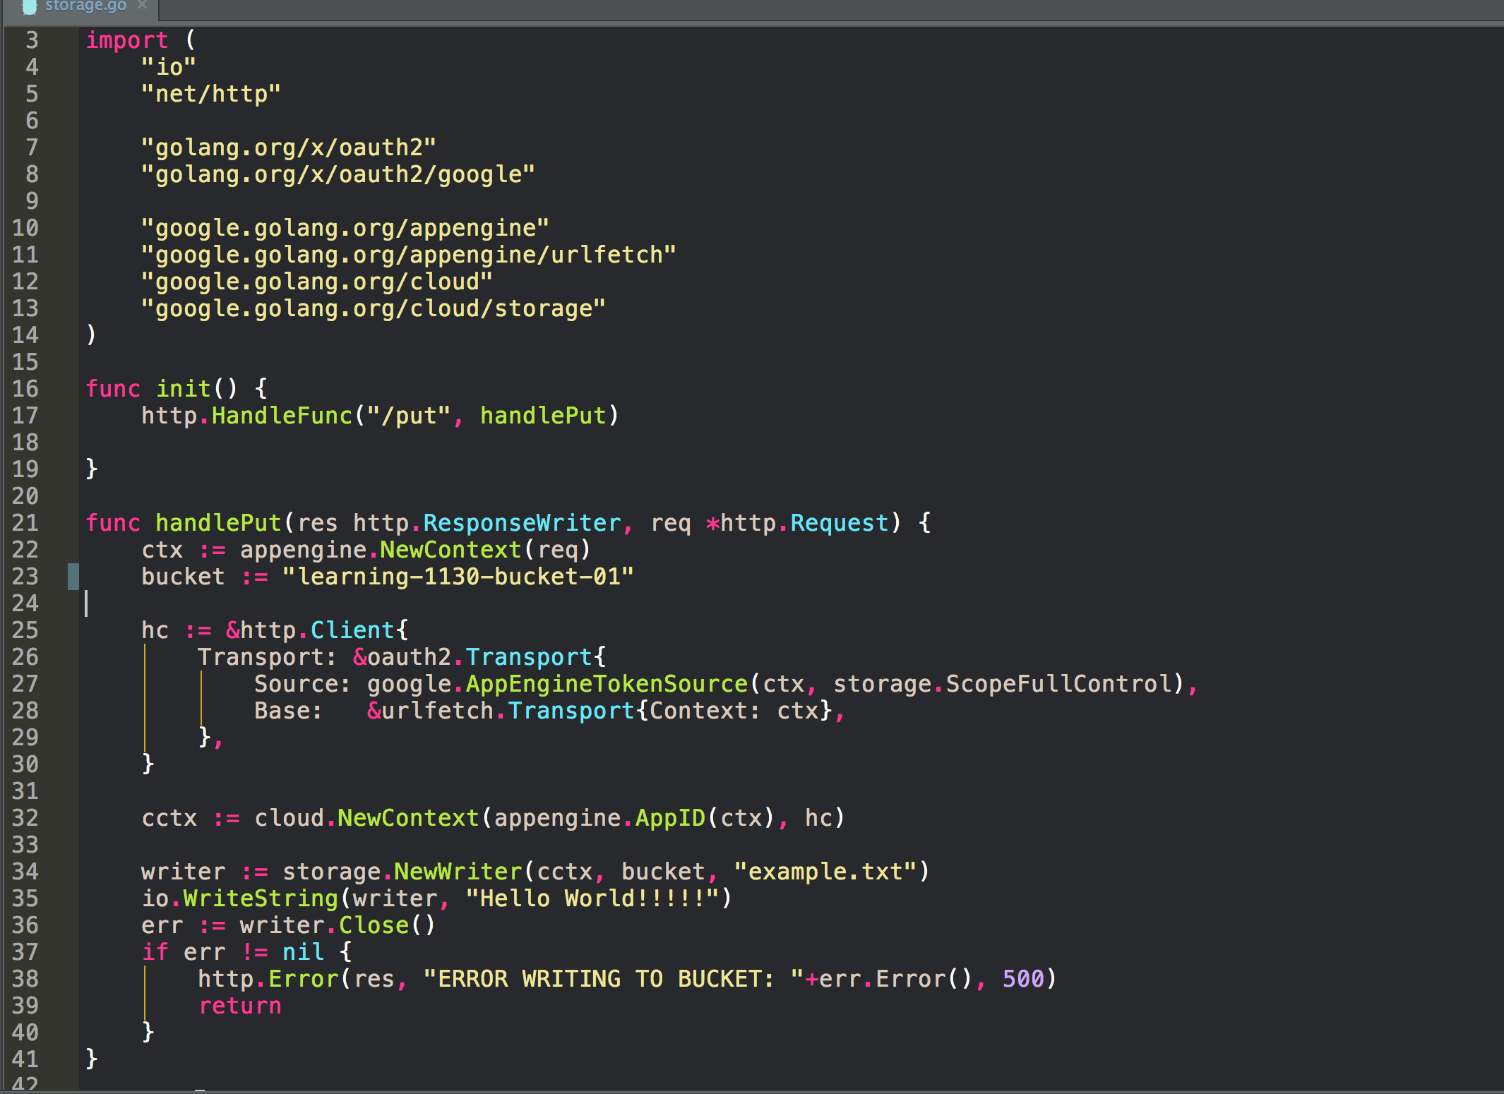

Slide 15
https://cloud.google.com/appengine/docs/go/googlecloudstorageclient/getstarted
download p12 for service account
convert to pem
terminal this:
/path/to/AppEngSDK/dev_appserver.py . --appidentity_email_address <your_app_email_address>@developer.gserviceaccount.com --appidentity_private_key_path pem_file.pem

Slide 16
JSON AUTH
(new way)

Slide 17
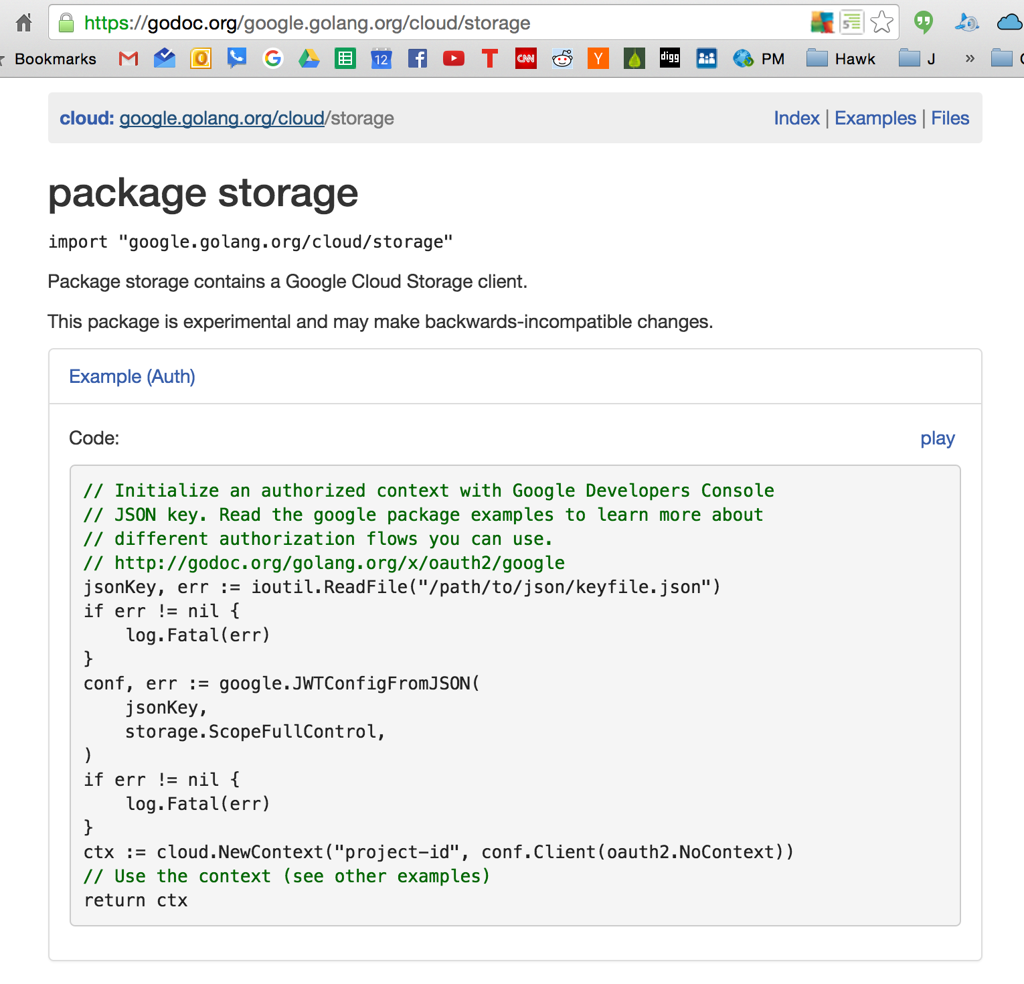

Slide 18
code
write code for your app to work with GCS

Slide 19
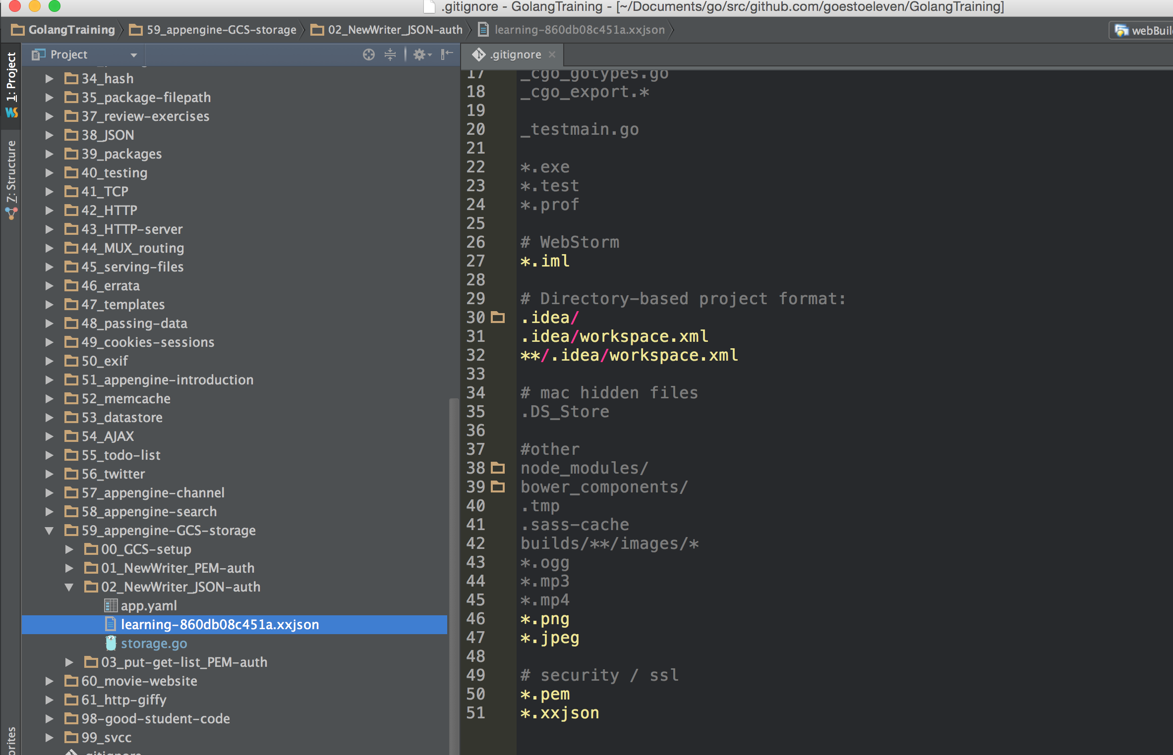

Slide 20
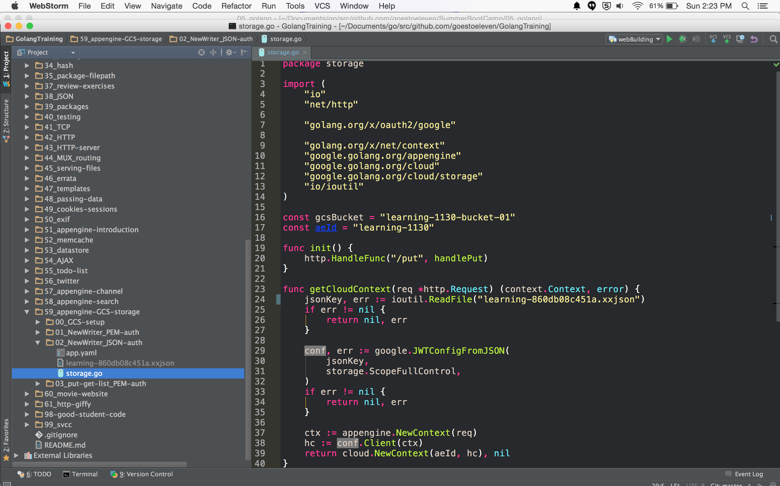

Slide 21
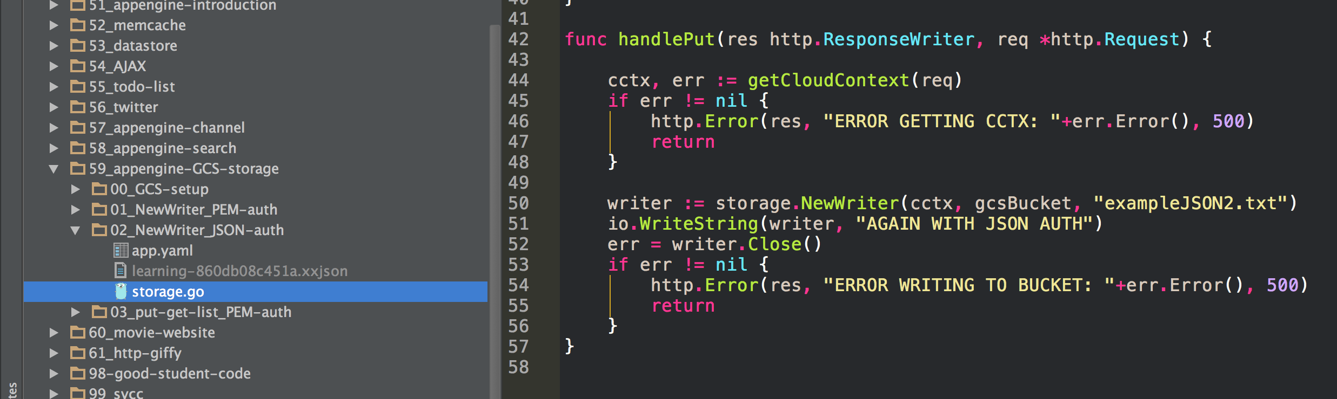

Slide 22
